Slide 1

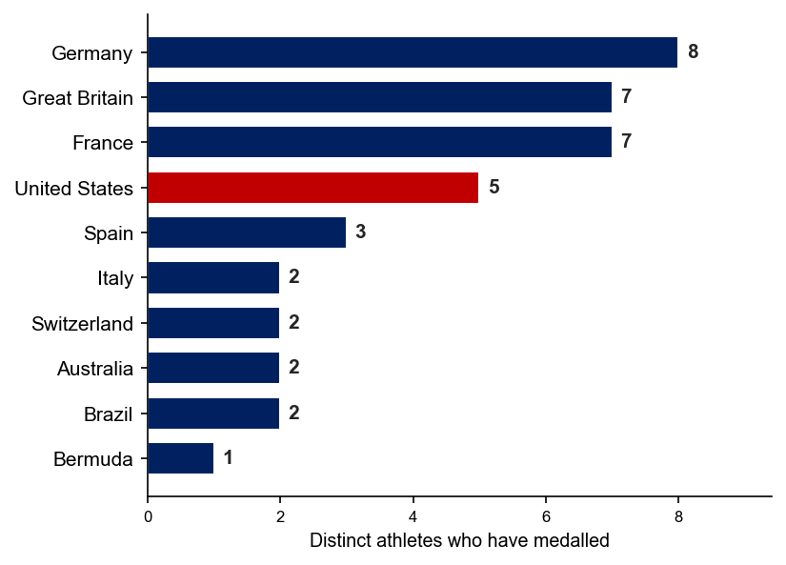
Total Medals by Nation
Distinct athletes who have won a WTCS or Olympic medal · Jul 2022–Jul 2026 (4 yrs)
48
19
5
medallists in 4 yrs 25 men · 23 women
nations have ANY WTCS/Olympic medallist
USA medalists: 4th-most of any nation
Distinct medallists by nation (top 10)
Only 23 women on the planet have won a WTCS or Olympic medal in 4 years and the USA has 3 of them, tied for the 3rd-most of any nation. The men’s side tells a similar story with only 25 men obtaining medals at the highest level, with the USA claiming two of those athletes
USA's proven medallists (WTCS + Olympic)
USA medallist | Medals | Last WTCS medal
Taylor Knibb (W) | 4 | May 2024
Taylor Spivey (W) | 3 | Sep 2025
Summer Rappaport (W) | 1 | Jun 2023
Morgan Pearson (M) | 2 | May 2024
John Reed (M) | 1 | Sep 2025
MAJORS = World Triathlon Championship Series/Finals rounds + individual Olympic medals (Elite Men/Women). Excludes Mixed Relay (team), T100, and regional/distance championships. Source: World Triathlon results database.

Slide 2
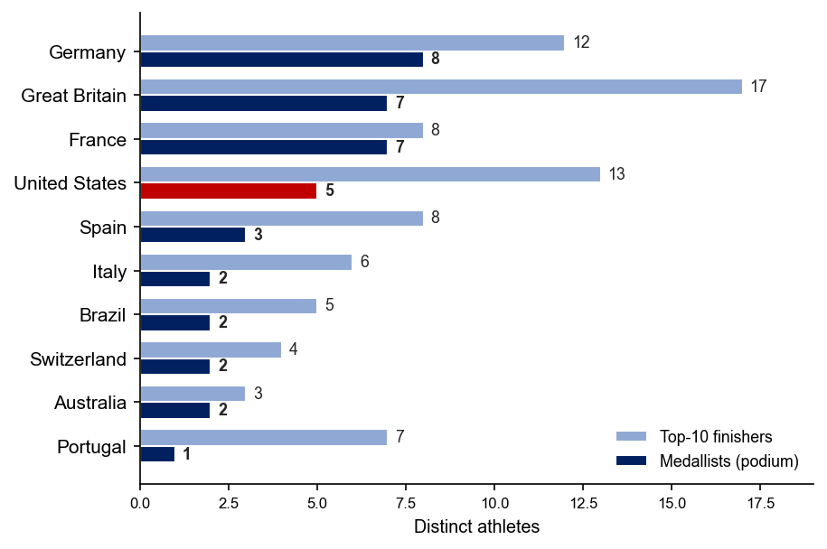
Top 10 Finishes by Nation
USA has the 2nd-deepest pool of top-10 athletes in the world
Podium medallists vs. top-10 finishers, by nation (top 10)
The global funnel (4 yrs, WTCS + Olympic)
122
80
48
reached a top-10
reached a top-6
won a medal
USA Successfully Building Out Detailed Pipeline
USA: 5 medalists and 13 top-10 finishers. This is currently the 2nd-deepest pipeline in the world, and does not include several other young developing athletes succeeding at the World Cup stage.
Top-10 counts include the medallists. MAJORS = World Triathlon Championship Series/Finals rounds + individual Olympic medals (Elite Men/Women). Excludes Mixed Relay (team), T100, and regional/distance championships. Source: World Triathlon results database.

